Slide 1
Linear Regression – 2
NPTEL Lecture - https://www.youtube.com/watch?v=xXDoZLVjfbs&list=PLLy_2iUCG87CNafffzNZPVa9rW-QmOmEv&index=30

Slide 2

















Slide 3
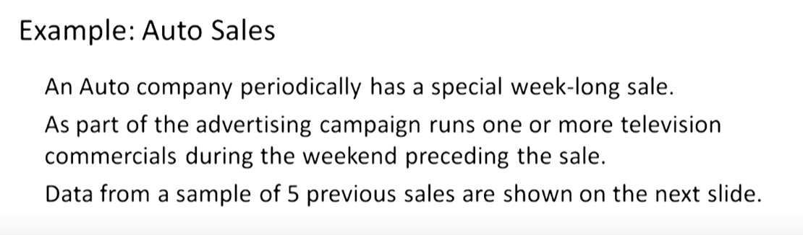


Slide 4
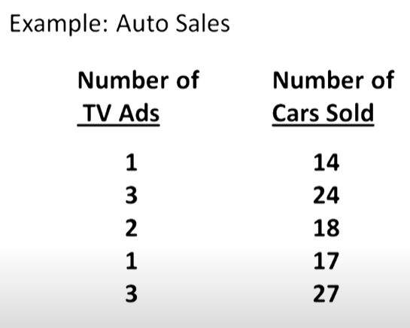






Slide 5














Slide 6
Using Excel
TV Ads | Cars Sold
1 | 14
3 | 24
2 | 18
1 | 17
3 | 27
Step 1: Select Data and click on Insert tab.
Step 2: Go to the chart and select ‘Scatter’ to get a scatter plot
Step 3: On the chart, right click on the data points and click on ‘Add Trendline’.
Step 4: From the window opening on the right side, click on ‘Display equation on the chart’ to get the best fit estimated regression equation.

Slide 7
Using Python: Problem #1
add_constant(data): This appends a column of ones to the array if prepend == False. By default, statsmodels fits a line passing through the origin, i.e. it doesn't fit an intercept. Hence, you need to use thecommand 'add_constant' so that it also fits an intercept.
OLS or Ordinary Least Squares is a method in Linear Regression for estimating the unknown parameters by creating a model which will minimize the sum of the squared errors between the observed data and the predicted one. ... using linear regression model, a straight line is fitted.
The fit() method takes the training data as arguments, which can be one array in the case of unsupervised learning, or two arrays in the case of supervised learning. Note that the model is fitted using X and y , but the object holds no reference to X and y .
import pandas as pd
import matplotlib.pyplot as pyplt
import statsmodels.api as sm
data = pd.read_excel("AutoSales_Data.xlsx")
data.plot('TV Ads','Cars Sold', style='*')
pyplt.ylabel('Cars Sold')
pyplt.title('Auto Sales’)
t = data['TV Ads’]
c = data['Cars Sold’]
t = sm.add_constant(t)
model1 = sm.OLS(c,t)
result = model1.fit()
print(result.summary())

Slide 8
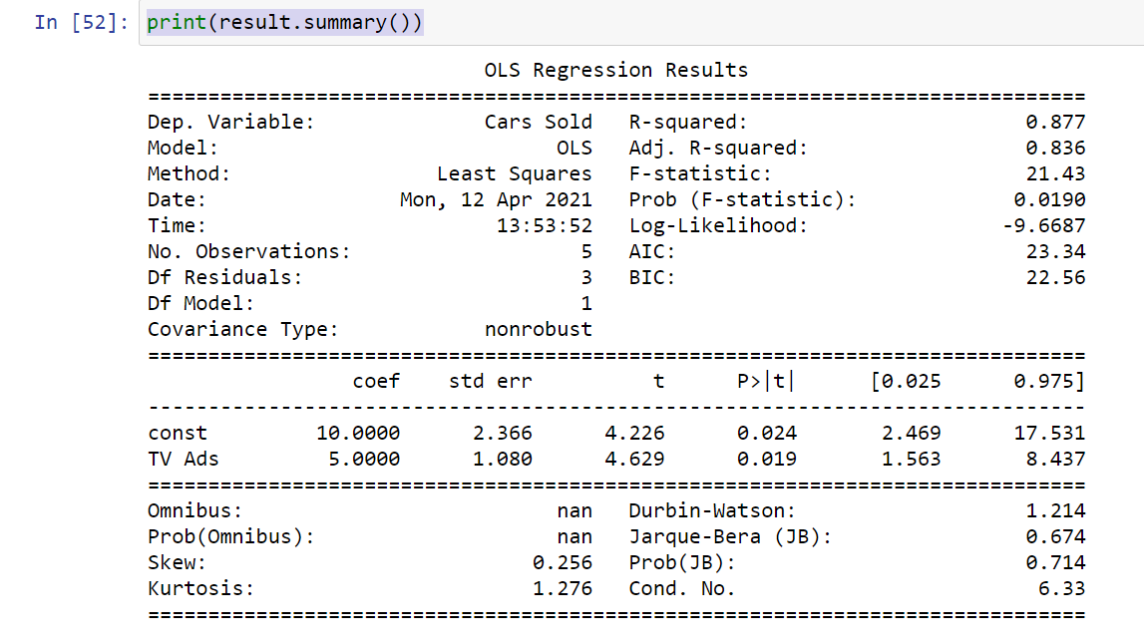

Slide 9
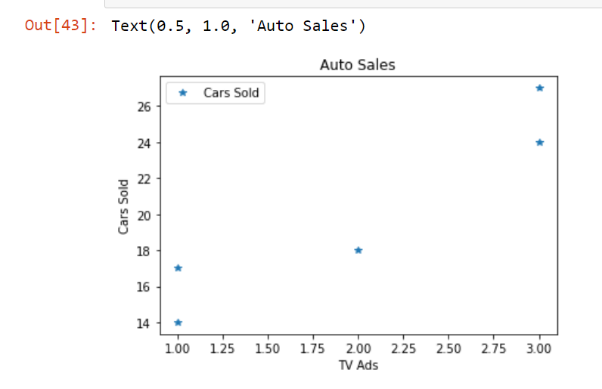

Slide 10
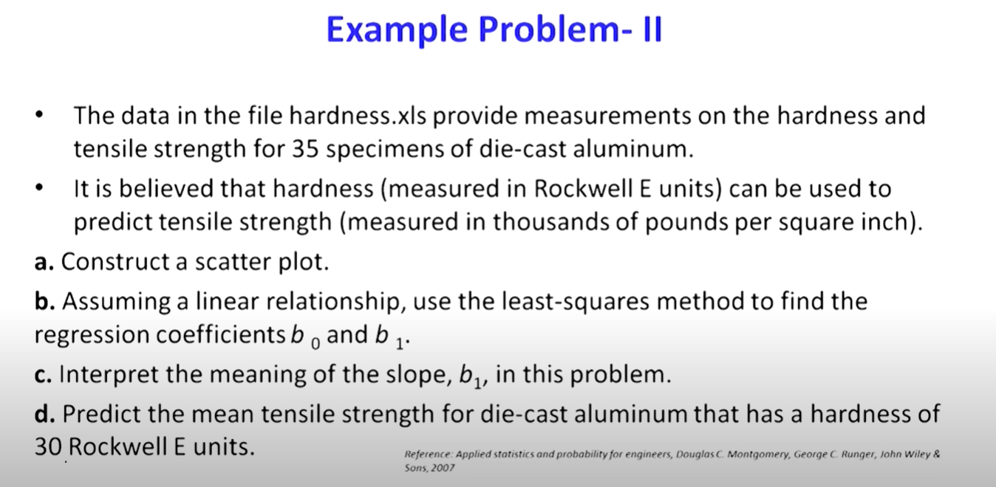

Slide 11
Using Python: Problem #2
Contd…..
reg = LinearRegression()
reg.fit(x_reshape,y_reshape)
plt.scatter(x,y)
y_predict = reg.predict(x)
plt.plot(x, y_predict, color = 'red')
plt.xlabel('Tensile Strength')
plt.ylabel('Hardness')
plt.title('Linear Regression - Hardness to predict the tensile strength’)
reg.intercept_
reg.coef_
from sklearn.metrics import mean_squared_error
mean_squared_error(y, y_predict)
reg.score(x_reshape,y_reshape)
import pandas as pd
import matplotlib.pyplot as plt
from sklearn.linear_model import LinearRegression
data = pd.read_excel('Hardness.xlsx’)
x = data['Tensile Strength’]
x.ndim
x.shape
x_reshape = x.reshape(-1,1)
x.ndim
x.shape
y = data['Hardness’]
y.ndim
y.shape
y = y.reshape(-1,1)
y.ndim
y.shape

Slide 12
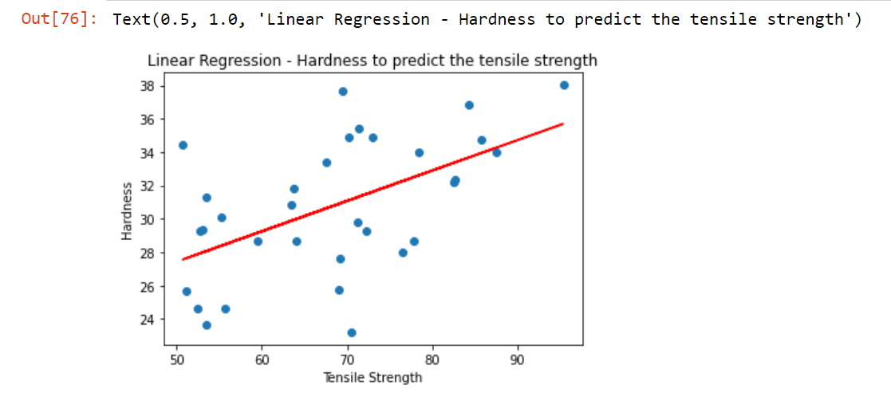

Slide 13
